Slide 1
NIFTY 50 Risk Radar
FINAL DATA SCIENCE CAPSTONE
Which Indian stocks are risky, when risk is rising, and how to build a calmer portfolio.
Santosh | Data Engineer Internship, Mumbai | 2026
Notes:
Hi, I am Santosh. My capstone is called the NIFTY 50 Risk Radar. It looks at 25 large Indian stocks over 10 years and answers three questions: which stocks are risky, can we get an early warning when a stock is about to get bumpy, and can we build a portfolio that survives crashes better than the index.

Slide 2
Return alone hides the risk
THE PROBLEM
Bajaj Finance grew 30% a year for ten years, and still fell 62% from its peak on the way. An advisory team needs to see both sides.
1
2
3
Which stocks are steady, and which are wild?
Can we get a warning before a stock turns bumpy?
Can a portfolio survive a crash better than the index?
Notes:
Most beginners choose stocks by last year's return. But a stock that earned 30% a year can also fall 60% from its peak. The stakeholder is an advisory team managing large-cap Indian stocks for retail clients, and these are the three questions I wanted to answer with data.

Slide 3
10 years of real market data
DATA AND APPROACH
25
2,674
60,375
NIFTY 50 stocks, plus the index and India VIX
trading days, Jan 2016 to Oct 2026
stock-days to train and test the alert model
STEP 1
STEP 2
STEP 3
STEP 4
Risk KPIs
Risk groups
Alert model
Back-test
Return, volatility, Sharpe, worst fall, beta
KMeans clustering of the stocks
Logistic Regression and Random Forest
Equal weight and minimum variance vs the index
Notes:
The data comes from Yahoo Finance through the yfinance library, downloaded and cleaned in Python in Google Colab. After cleaning there are 2,674 trading days with no missing values. For the alert model I built 13 features per stock per day, which gives 60,375 rows. Then four steps: risk KPIs, risk groups with KMeans, the alert model, and a portfolio back-test.

Slide 4
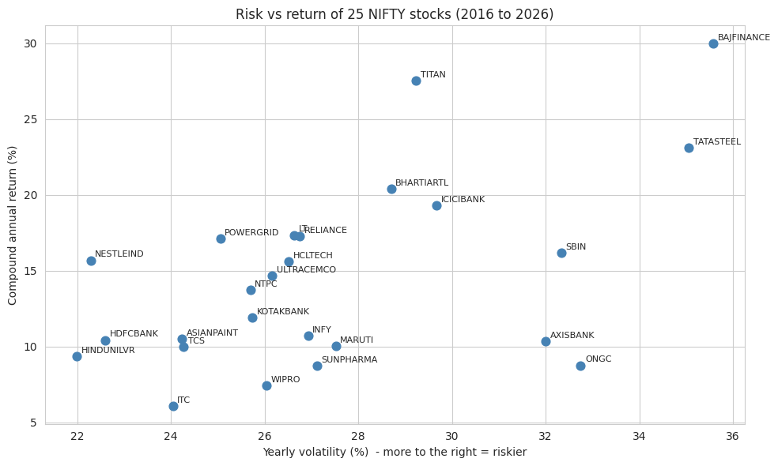
More return needs more risk, up to a point
RISK AND RETURN
Titan: Sharpe 0.74
Best return for the risk taken
Bajaj Finance: 30%
Highest return, but also 35.6% volatility
ONGC, Axis, SBI
32% to 33% volatility for only 9% to 16% a year
Notes:
Each dot is a stock. Right means riskier, up means higher return. Titan and Bajaj Finance earned the most. Bajaj Finance is also the most volatile and had the largest beta. ONGC, Axis Bank and SBI carried a lot of risk but did not earn much for it. The index itself grew 10.8% a year with 16.1% volatility.

Slide 5
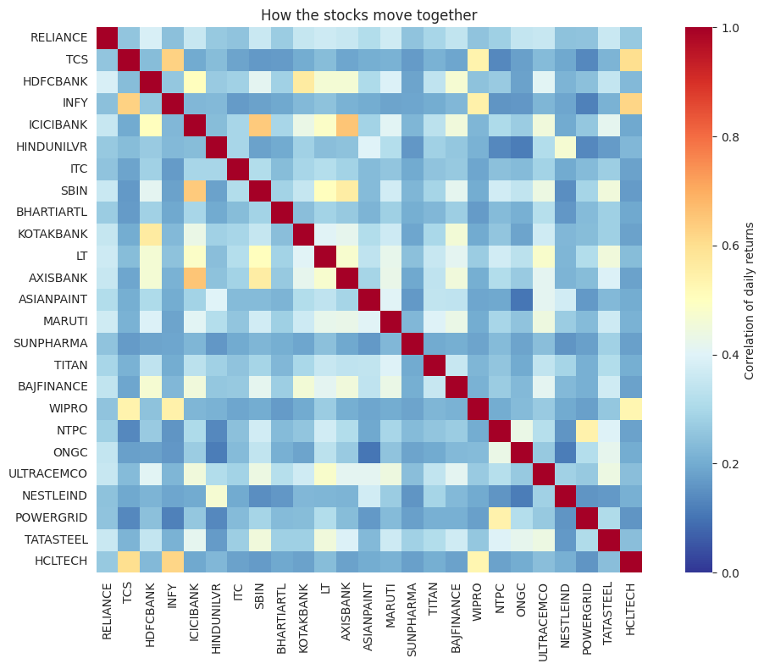
Every stock is riskier than the index
DIVERSIFICATION
16.1%
yearly volatility of the NIFTY 50 index
22% to 36%
volatility of each single stock
0.28
average correlation: stocks do not move together, so mixing them cancels risk
Notes:
This is the diversification effect. Even the calmest stock, Hindustan Unilever at 22%, is more volatile than the index at 16.1%, because the stocks only have an average correlation of 0.28. The heatmap shows blocks: the private banks and SBI move together at 0.64 to 0.65, and the IT stocks TCS and Infosys at 0.63. ONGC has the lowest correlation with Hindustan Unilever, Nestle and Asian Paints, around 0.10 to 0.12, so those mixes diversify the most.

Slide 6
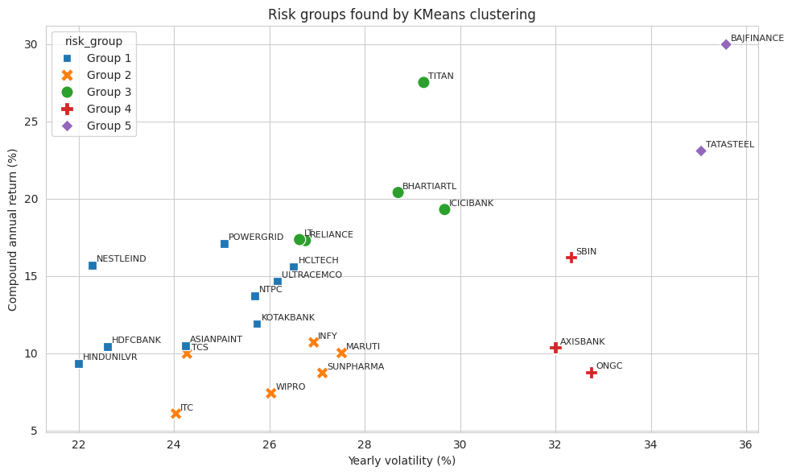
Five risk profiles found by KMeans
RISK GROUPS
1 Steady core (9 stocks)
Smallest worst fall: 37.5%
2 Poor reward (6 stocks)
Return 8.8%, Sharpe only 0.11
3 Quality growers (5)
Return 20.4%, Sharpe 0.51
4 Risk, little reward (3)
SBI, Axis, ONGC: 64% worst fall
5 High risk, high return (2)
Bajaj Finance, Tata Steel
Notes:
I clustered the stocks on return, volatility, maximum drawdown and beta. The silhouette score is about 0.30, so the groups overlap and should be read as soft profiles. Group 1 has HDFC Bank, Hindustan Unilever, Kotak, Asian Paints, NTPC, UltraTech, Nestle, Power Grid and HCL Tech. Group 2 has TCS, Infosys, ITC, Maruti, Sun Pharma and Wipro. Group 3 has Reliance, ICICI Bank, Bharti Airtel, L and T and Titan. The labels are my own reading of the numbers. Groups are based on 2016 to 2026 history, so they can change.

Slide 7
Will the next 5 days be unusually volatile?
EARLY-WARNING MODEL
TARGET
13 FEATURES
Next 5-day volatility is above the stock’s own 75th percentile of the past year. This happened on 25.5% of days.
Known on that day only: stock returns, volatility, volume, distance from the 60-day high, VIX and NIFTY moves.
Split by time, never at random
Train
Test
Jan 2017 to Dec 2022: 36,675 stock-days
2023 to Oct 2026: 23,500
A gap of about 8 trading days separates them, so no training row can see into the test period.
Notes:
I deliberately do not predict whether the price goes up or down tomorrow, because that is close to a coin flip. The question is whether the next week will be unusually bumpy for a stock, compared with that stock's own past year. Every feature uses only information known on the day. The split is by time, with a gap, so the model cannot peek into the future.

Slide 8
A weak but real signal
MODEL RESULTS ON THE TEST PERIOD
Model | Accuracy | Recall | ROC-AUC
Always calm | 0.737 | 0.000 | 0.500
Persistence rule | 0.652 | 0.331 | 0.583
Logistic Regression | 0.649 | 0.396 | 0.592
Random Forest | 0.676 | 0.286 | 0.584
0.592
best ROC-AUC, against 0.583 for a simple rule and 0.5 for a guess
Accuracy misleads here. “Always calm” scores the highest (0.737) but never finds a single risky day, so I judge the models on ROC-AUC and recall.
Notes:
All numbers are on the 2023 to 2026 test period, which the models never saw. Logistic Regression is the best by AUC, but only slightly better than the persistence rule. The honest summary is that volatility is hard to predict from daily closing prices, and the model beats the baselines by a small margin. At the default threshold, it caught 2,440 of 6,169 high-volatility days, with 4,521 false alarms.

Slide 9
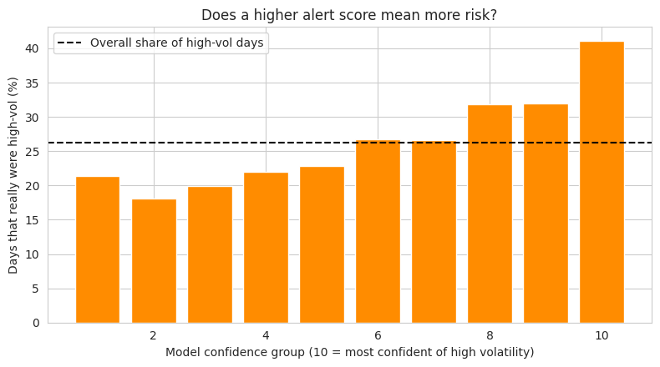
Higher alert score, more risky days
DOES THE ALERT SCORE MEAN ANYTHING?
41.1%
of the top 10% of alerts were really high-volatility days
26.3%
overall rate
21.4%
in the lowest 10% of scores
Use it to rank stocks, not to sell: even in the top group, most alerts are false.
Notes:
This is the most useful view for the business. I sorted all test days by the model's score and cut them into ten equal groups. In the top group, 41.1% of the days were really high-volatility, which is about 1.6 times the overall rate of 26.3%. In the lowest group it was 21.4%. So the score ranks risk reasonably, but 59% of the top alerts are still false, which is why I recommend reducing position size, not selling.

Slide 10
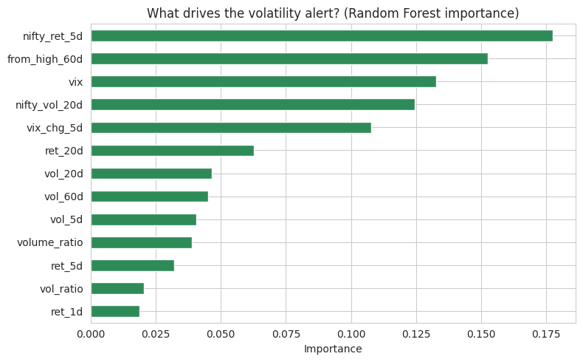
The market matters more than the stock
WHAT DRIVES THE ALERT
54%
of the importance sits in four market-wide features: NIFTY 5-day move, VIX, NIFTY volatility, VIX change
18.5 vs 15.7
average VIX before high-volatility periods vs calm ones
Notes:
The Random Forest importance shows that a stock's own volatility history matters much less than the market mood. The four market-wide features together hold about 54% of the importance. The VIX supports this: it averaged 18.5 before high-volatility periods and 15.7 before calm ones. Importance values are only a guide, I did not run a permutation test.

Slide 11
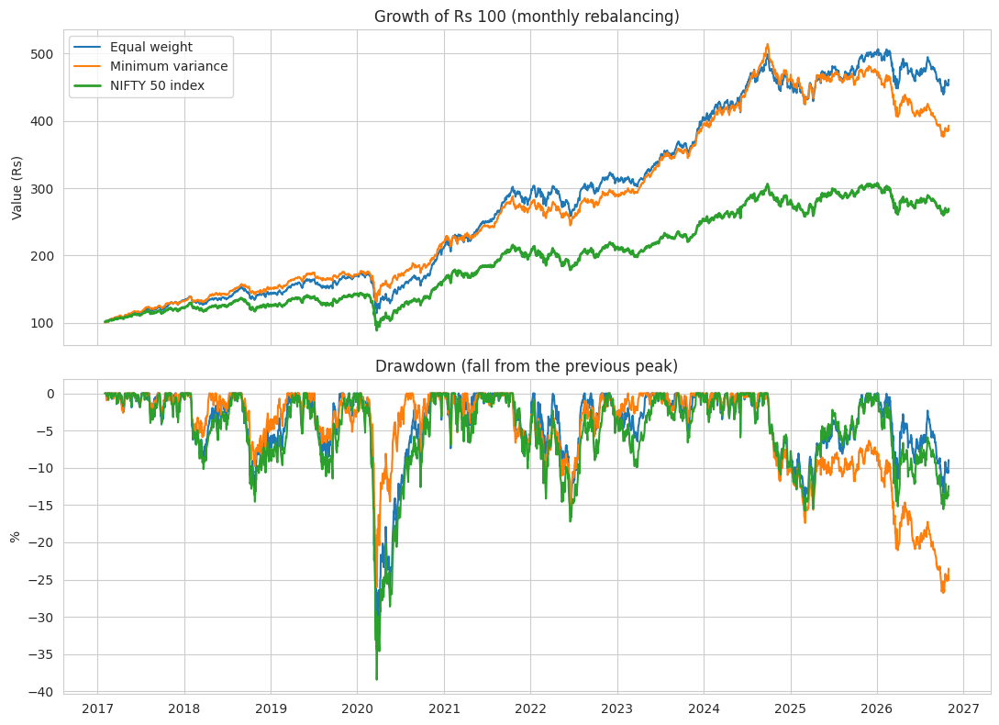
A calmer ride than the index
PORTFOLIO BACK-TEST, FEB 2017 TO OCT 2026
Strategy | Return | Vol. | Worst fall
Equal weight | 17.3% | 15.4% | -34.4%
Min-variance | 15.4% | 13.5% | -26.8%
NIFTY 50 | 10.9% | 16.3% | -38.4%
COVID crash, 2020
Min-variance fell 24.7%. The index fell 36.5%.
Notes:
Each month I used the past 252 days of returns to find the long-only weights with the lowest portfolio variance, with a 15% cap per stock, and held that for the next month. No future data is used. The minimum-variance portfolio had the lowest volatility and, in the COVID crash from 19 February to 23 March 2020, fell 24.7% against 36.5% for the index. Note that equal weight beating the index is flattered by two biases that I explain on the next slide.

Slide 12
What to be careful about
HONEST LIMITS
Survivorship bias
A modest model
I picked stocks that are in the NIFTY 50 today. Stocks that dropped out are missing, so portfolio returns look better than real life.
ROC-AUC 0.59 beats the baselines only slightly, tested on one period, with little tuning.
Dividends
The 2026 lag
Stock prices include dividends, but the index (^NSEI) is price only. The return comparison is not like for like.
The min-variance worst fall (-26.8%) came in late 2026, not 2020. Low-risk portfolios can lag and need regular review.
Notes:
I want to be upfront about these. Survivorship bias and dividends both flatter the stock portfolios against the index, so I trust the volatility and drawdown comparison more than the return comparison. The alert model is a modest ranking tool. And the minimum-variance portfolio's worst drawdown is at the end of the data, in late 2026. I did not investigate why. Also, no transaction costs or taxes are included.

Slide 13
Recommendations
FOR AN ADVISORY TEAM
1
2
Build around Group 1
Diversify across unlike stocks
Use the steady core, with a small satellite from Group 3.
ICICI, Axis and SBI move together (0.64 to 0.65). They are not three separate bets.
3
4
Alerts size down, not sell
Offer capped min-variance
Put the top 20% of alerts on a watch list and watch the VIX first.
For cautious clients, rebalanced monthly, with a quarterly review.
Educational project based on historical data. Not investment advice.
Notes:
These are for an advisory team and are based only on this data. One: build around the steady Group 1 stocks. Two: diversify across stocks that do not move together. Three: use the alert score to reduce position size or tighten reviews, not as a sell signal, because most alerts are false. Four: offer a capped minimum-variance option for cautious clients and review it each quarter. This is an educational project and not investment advice.

Slide 14
Know the risk before you chase the return
TAKEAWAYS
Five risk profiles, and every stock is riskier than the index.
A modest but real early-warning signal, driven by market stress.
A calmer portfolio: 13.5% volatility and a smaller COVID loss.
Thank you | Santosh
github.com/Santoshgutte1522/data-engineer-internship
Notes:
To finish: five risk profiles, with every stock riskier than the index because stocks do not move together. A modest early-warning signal that is driven mainly by market stress. And a minimum-variance portfolio with lower volatility and a smaller COVID loss, with the honest caveats I showed. Next steps are delisted stocks and a total-return index to remove the biases, sector and fundamental data, and a small web app that ranks stocks each day. Thank you.

